Slide 1
The identity property of multiplication and division
Comparing and ordering fractions and decimals (positive and negative)

Slide 2
how to use Oak lessons

Slide 3
I can use the fact that 1 can be written in the form
and vice versa.

Slide 4
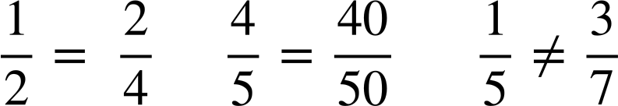
Two fractions are equivalent if they have the same value.
Example
Example
Non example

Slide 5

The identity property of multiplication and division
Bar models and number lines
Property of multiplication

Slide 6
Bar models and number lines
Two fractions are equivalent if they have the same value.
Let’s look at some equivalent fractions using bars to show they are the same value.

Slide 7

Bar models and number lines
For example, what fraction do you have here?
Divide each part by two, what do you have?
Divide each part by two again, what do you have?

Slide 8
Bar models and number lines
All of these are equivalent. There are an infinite number of equivalent fractions.
They are equivalent because we have simply subdivided each equal part.

Slide 9


Bar models and number lines
Aisha has a fraction shaded.
Show, using dividing lines to show the sub-division, how she can make the other equivalent fractions.

Slide 10

Bar models and number lines
Let’s look at some equivalent fractions using number lines to show they are the same value.
For example, draw an arrow indicating
0
1
Draw an arrow indicating
0
1
Draw an arrow indicating
0
1

Slide 11
Bar models and number lines
All of these are equivalent. There are an infinite number of equivalent fractions.
They are equivalent because we have simply subdivided each equal part.
0
1
0
1
0
1

Slide 12

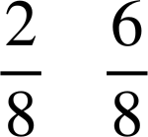
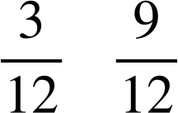
Bar models and number lines
0
1
0
1
0
1

Slide 13





Bar models and number lines

Slide 14
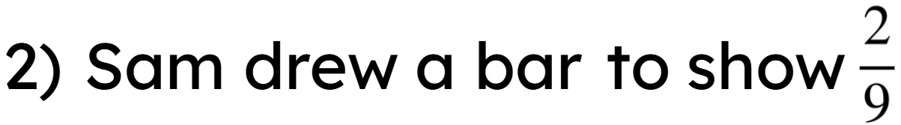


Bar models and number lines
Sam then drew another bar underneath
which
shows
Is Sam correct? Explain why.

Slide 15
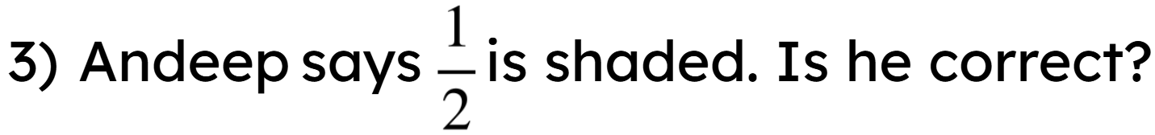
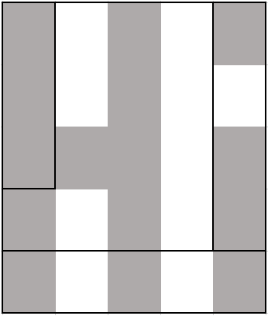
Bar models and number lines
You can show your working out on the diagram.

Slide 16
Bar models and number lines
Lots of different ways as long as you have equal parts

Slide 17
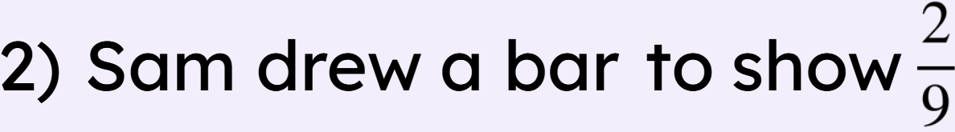
Bar models and number lines
Sam then drew another bar underneath
which
shows
Incorrect. The bar that represents the whole must be the same length to compare fractions this way.
Is Sam correct? Explain why.

Slide 18
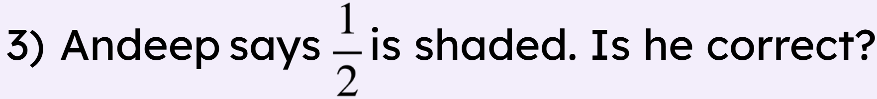
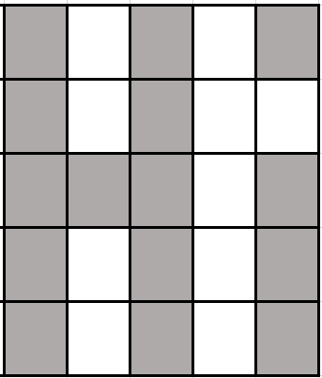

Bar models and number lines
You can show your working out on the diagram.
Andeep is incorrect. Splitting the shape equally, there are 15 out of 25
15 out of 25 shaded is not equivalent to

Slide 19
The identity property of multiplication and division
Bar models and number lines
Property of multiplication

Slide 20
Property of multiplication
Bar models and number lines are very good visual ways to see equivalent fractions, but they do take time to construct.
Let’s look at some equivalent fractions using multiplication of 1 to show they are the same value.
This method is more effective and quicker.
We know any number multiplied by 1 is always itself.

Slide 21
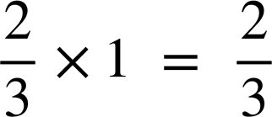
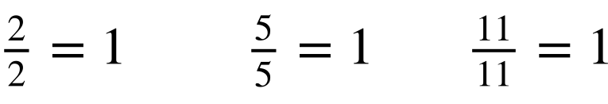
Property of multiplication
We know any number multiplied by 1 is always itself.
For example,
We also know any fraction can be written as 1
So we can combine these two facts to make an equivalent fraction.

Slide 22
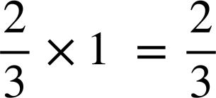
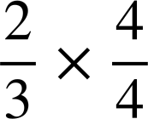
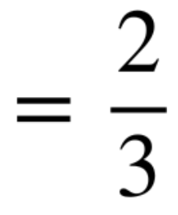
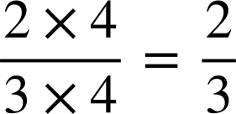
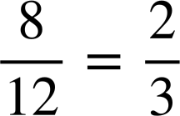
Property of multiplication
Therefore we know
We have equivalent fractions.

Slide 23
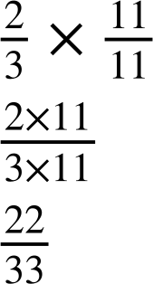
Property of multiplication
We can use 1 to be any fraction
We have equivalent fractions.

Slide 24
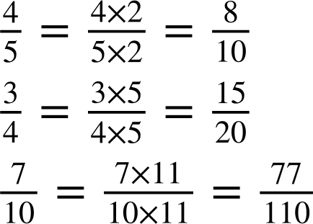
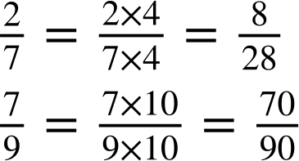
Property of multiplication
Fill in the gaps to identify the equivalent fractions.
a)
b)
Fill in the gaps to identify the equivalent fractions.
a)
b)

Slide 25
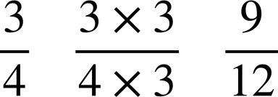
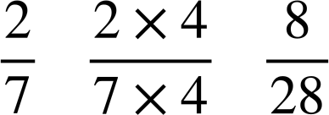
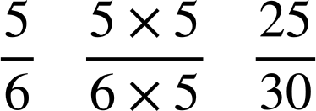
Property of multiplication
Fill in the table to show the fraction, working out and the equivalent fraction.
Fraction | Working out | Equivalent fraction

Slide 26
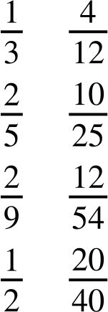
Property of multiplication
Match the equivalent fractions.

Slide 27
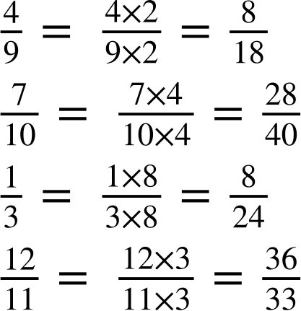
Property of multiplication
Fill in the gap to show the fraction, working out and equivalent fraction.
a)
c)
b)
d)

Slide 28






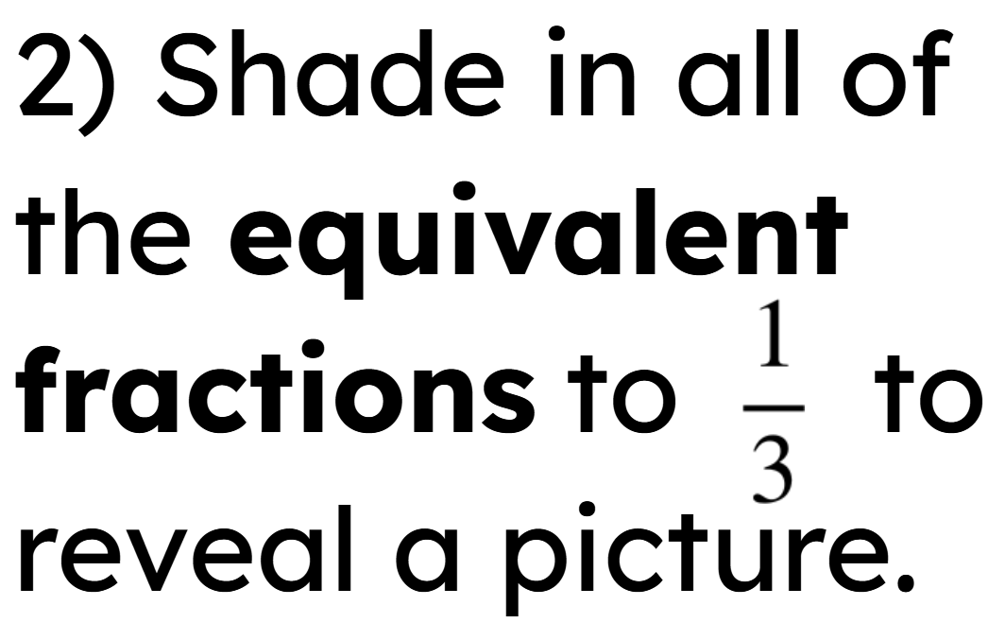





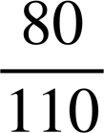
Property of multiplication

Slide 29
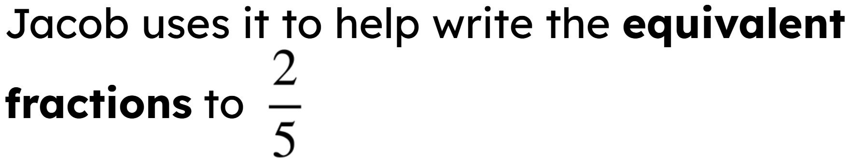
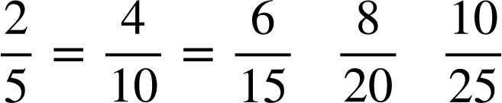
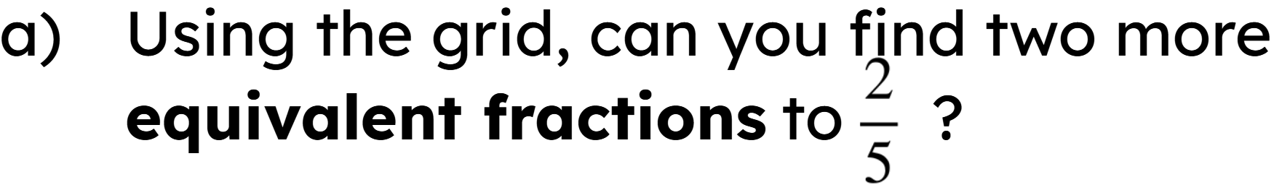
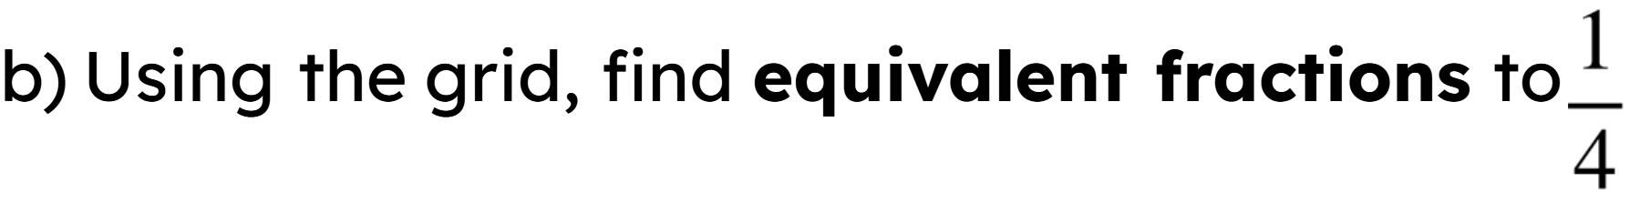
Property of multiplication
3) Here is a 5 by 5 multiplication grid.
1 | 2 | 3 | 4 | 5
2 | 4 | 6 | 8 | 10
3 | 6 | 9 | 12 | 15
4 | 8 | 12 | 16 | 20
5 | 10 | 15 | 20 | 25
He sees

Slide 30
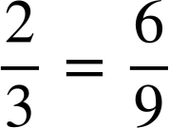
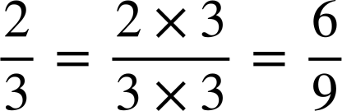
Property of multiplication
4) Show
using numbers lines, bar models and multiplication of 1.
0
1
0
1

Slide 31
Property of multiplication
Fill in the gap to show the fraction, working out and equivalent fraction.
a)
c)
b)
d)

Slide 32
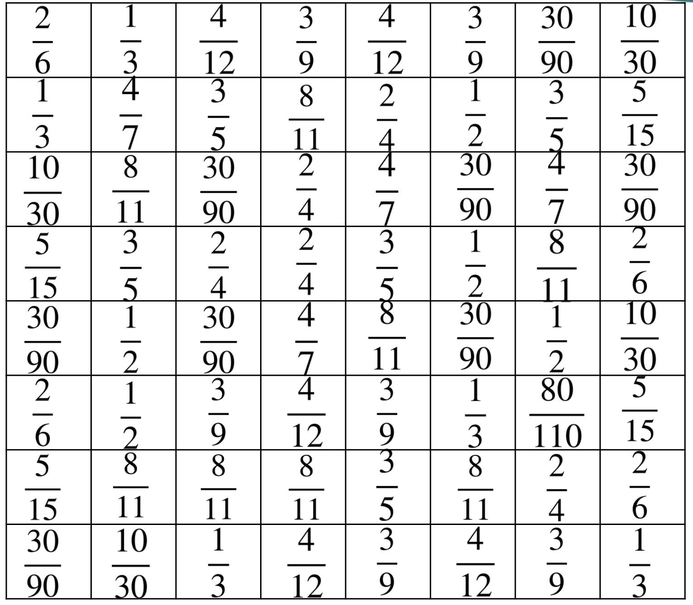
Property of multiplication
2) Shade in all of
the equivalent
fractions
to
to
reveal a picture.

Slide 33
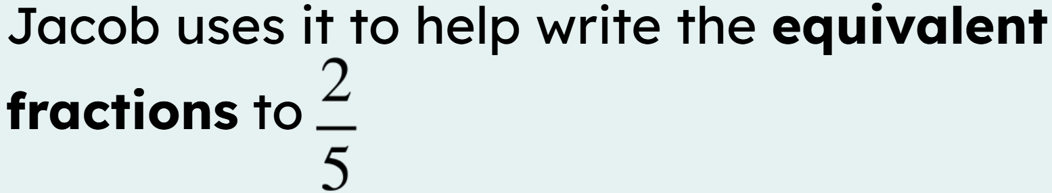
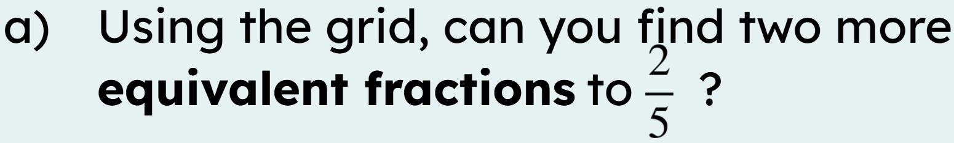
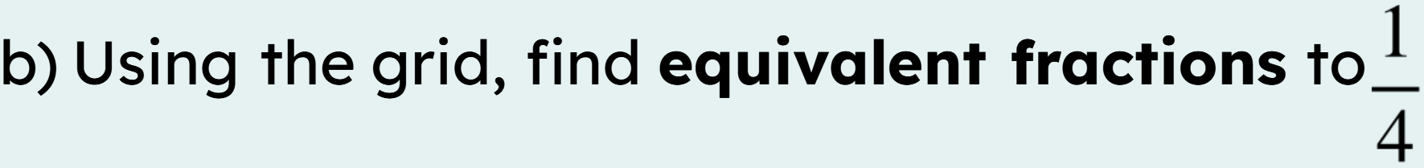
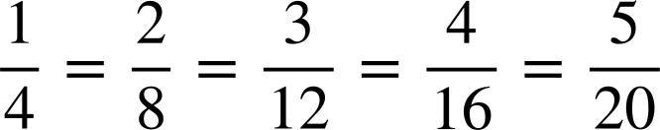
Property of multiplication
3) Here is a 5 by 5 multiplication grid.
1 | 2 | 3 | 4 | 5
2 | 4 | 6 | 8 | 10
3 | 6 | 9 | 12 | 15
4 | 8 | 12 | 16 | 20
5 | 10 | 15 | 20 | 25
He sees
and

Slide 34
Property of multiplication
4) Show
using numbers lines, bar models and multiplication of 1.
0
0
1
1
0
1

Slide 35
The identity property of multiplication and division
Two fractions are equivalent if they have the same value.
Example
Example
Non example
There are different ways to show equivalent fractions. For example, number lines, bar models and multiplying by 1.
The method of multiplying by 1 is most effective as it saves time.

Slide 36

© Oak National Academy 2023.
Produced in partnership with Mathematics in Education and Industry.
Licensed on the Open Government Licence v3.0, except where otherwise stated. See Oak terms and conditions.

